Slide 1

GenAI Basics
Claude Ecosystem
and Artifacts
From chat answers to reusable work products
Module 09 · 90–120 minutes
GenAI Basics · Module 09
1
Notes:
Module 09 slide 1. Use the instructor script for full narration. Keep the frame practical: artifact, tests, governance.

Slide 2

Why Claude in this course?
The unit of work shifts from an answer to something you can inspect and reuse
Chat answer
fast, useful, but easy to lose
Artifact
visible, editable, testable, reusable
→
Professional question
Does the artifact solve the task when a real person uses it?
Not: “does it look impressive for five seconds?”
GenAI Basics · Module 09
2
Notes:
Module 09 slide 2. Use the instructor script for full narration. Keep the frame practical: artifact, tests, governance.

Slide 3
Learning objectives
By the end, students can turn Claude output into a controlled work product
✓
Choose the right Claude surface for a task
Student output
✓
Design an Artifact request with constraints and tests
Artifact Build Brief
+ prompt
+ acceptance matrix
+ one revised artifact
✓
Run build → inspect → revise instead of accepting first output
✓
Explain tools, files, citations, context, caching and Skills
✓
Spot sharing, privacy and dependency risks
Useful later for agents and Streamlit prototypes
GenAI Basics · Module 09
3
Notes:
Module 09 slide 3. Use the instructor script for full narration. Keep the frame practical: artifact, tests, governance.

Slide 4
Claude ecosystem map
Use the map to choose a surface before choosing a prompt
Chat / Desktop
Artifacts
Projects &
Connectors
→
↓
←
Claude
conversation core
→
↑
←
Claude Code
Developer
Platform
Cloud /
Enterprise
Skills + tools wrap across surfaces, but availability and governance differ.
GenAI Basics · Module 09
4
Notes:
Module 09 slide 4. Use the instructor script for full narration. Keep the frame practical: artifact, tests, governance.

Slide 5
Choose the surface
A fast decision path for real work
Need quick thinking or draft?
→
Chat
The wrong surface creates fake productivity: fast demo, slow deployment.
↓
Need a reusable object?
→
Artifact
↓
Need repo changes?
→
Claude Code
↓
When in doubt, prototype in Artifact; operationalize through API only after the workflow survives tests.
Need product integration?
→
API / Managed Agent
↓
Need governed enterprise rollout?
→
Cloud + admin controls
GenAI Basics · Module 09
5
Notes:
Module 09 slide 5. Use the instructor script for full narration. Keep the frame practical: artifact, tests, governance.

Slide 6
What is an Artifact?
A standalone work product, not just a pretty answer
Artifact criteria
Document
Single-page app
Dashboard
✓
Substantial
Code snippet
Diagram
React component
✓
Self-contained
✓
Worth editing
✓
Worth reusing
The danger: finished-looking output can hide broken assumptions.
✓
Can stand outside the chat
That is why the next slide is a test loop, not a prompt trick.
GenAI Basics · Module 09
6
Notes:
Module 09 slide 6. Use the instructor script for full narration. Keep the frame practical: artifact, tests, governance.

Slide 7
Artifact workflow
The workflow matters more than the first prompt
Brief
→
→
Revise
Build
↑
↓
Test
Inspect
←
Share / export only after acceptance tests survive a revision.
GenAI Basics · Module 09
7
Notes:
Module 09 slide 7. Use the instructor script for full narration. Keep the frame practical: artifact, tests, governance.

Slide 8
Artifact prompt anatomy
A prompt here is closer to a product brief than a command
Purpose
Audience
Inputs
decision or workflow
who uses it
files, fields, assumptions
Output
Constraints
Acceptance tests
artifact type and behavior
privacy, tools, style
how we judge it
Revision policy: after the first draft, ask for specific changes tied to failed tests.
GenAI Basics · Module 09
8
Notes:
Module 09 slide 8. Use the instructor script for full narration. Keep the frame practical: artifact, tests, governance.

Slide 9
Weak vs strong request
The strong request can be evaluated
Weak
Strong
“Build a 3-minute
triage dashboard
with stale P1 warnings
and acceptance tests.”
“Make a dashboard
for these tickets.”
No user, no decision, no tests, no privacy boundary.
User, data, constraints, decision and visible pass/fail criteria.
GenAI Basics · Module 09
9
Notes:
Module 09 slide 9. Use the instructor script for full narration. Keep the frame practical: artifact, tests, governance.

Slide 10
Demo scenario
Support lead has three minutes before stand-up
Input data
Operational question
What should the support lead act on first this morning?
ID
Sev
Age
Owner
T-1001
P1
4d
Marta
T-1006
P1
5d
Marta
T-1010
P1
2d
missing
T-1005
P2
6d
missing
Acceptance tests decide quality
GenAI Basics · Module 09
10
Notes:
Module 09 slide 10. Use the instructor script for full narration. Keep the frame practical: artifact, tests, governance.

Slide 11
Live demo runbook
A reliable demo is designed like a small release
1
→
2
→
3
→
4
→
5
→
6
Prepare sanitized data
Generate artifact from brief
Inspect against tests
Request targeted revision
Discuss sharing boundary
Use local fallback if needed
No real customer data. No accidental publishing. No personal chat history on screen.
GenAI Basics · Module 09
11
Notes:
Module 09 slide 11. Use the instructor script for full narration. Keep the frame practical: artifact, tests, governance.

Slide 12
Developer mental model
The API makes tool use explicit
User request
Messages API
tool_use
Your app
executes
→
→
→
Final answer
/ artifact
←
tool_result
←
Your product owns state, permissions, logging, retries and side effects.
GenAI Basics · Module 09
12
Notes:
Module 09 slide 12. Use the instructor script for full narration. Keep the frame practical: artifact, tests, governance.

Slide 13
Files, PDFs and citations
Evidence workflow beats “trust me” workflow
Files API
upload once
Messages
with file_id
Claude
reads source
Answer
with citations
→
→
→
Design rule
Citations point to provided source material. They do not make weak sources reliable.
Multi-tenant warning: isolate workspaces and file access. “Same workspace” is not a tenant boundary by wishful thinking.
GenAI Basics · Module 09
13
Notes:
Module 09 slide 13. Use the instructor script for full narration. Keep the frame practical: artifact, tests, governance.

Slide 14
Context and prompt caching
Do not repack the suitcase every turn
Stable prefix
Changing turn
system instructions
latest user ask
tool definitions
timestamp
→
long reference docs
new file
style guide
changed tool settings
Cache stable prefixes. Changing tools, files, images or thinking settings can break value.
GenAI Basics · Module 09
14
Notes:
Module 09 slide 14. Use the instructor script for full narration. Keep the frame practical: artifact, tests, governance.

Slide 15
Skills
Reusable work instructions, scripts and resources
Skill folder
SKILL.md
scripts/
Claude discovers
when relevant
Better repeated
workflow output
→
→
templates/
examples/
Skill ≠ permission model. A Skill can help Claude work; your environment still owns access control.
GenAI Basics · Module 09
15
Notes:
Module 09 slide 15. Use the instructor script for full narration. Keep the frame practical: artifact, tests, governance.

Slide 16
Governance
The easiest leak is a beautiful artifact everyone wants to share
Risk
Control
Public link
Treat as publication; sanitize before sharing
Private by default
is not a deployment
strategy.
Org sharing
Check plan, tenant and access rules
Files
Separate tenant/workspace boundaries
Tools
Approve side effects; log actions
Decide: who can see it, who can change it, what data it contains, and what can execute.
Skills
Audit scripts and network behavior
GenAI Basics · Module 09
16
Notes:
Module 09 slide 16. Use the instructor script for full narration. Keep the frame practical: artifact, tests, governance.

Slide 17
Quality evaluation
Judge artifacts by task success, not demo applause
Task success
Answers the decision
Cost / latency
↑
Data handling
Viable for repeated use
←
→
Uses inputs correctly
PASS?
Use tests
←
→
Maintainability
↓
Usability
Readable and revisable
Clear in 3 minutes
Safety
No leakage or harmful action
GenAI Basics · Module 09
17
Notes:
Module 09 slide 17. Use the instructor script for full narration. Keep the frame practical: artifact, tests, governance.

Slide 18
Hands-on exercise
Build, test and revise one artifact
1
→
2
→
3
→
4
→
5
→
6
Choose scenario
Fill Build Brief
Generate/inspect
Run 5 tests
Revise once
Submit package
Output: build brief + prompt + acceptance matrix + final artifact or screenshot/link
GenAI Basics · Module 09
18
Notes:
Module 09 slide 18. Use the instructor script for full narration. Keep the frame practical: artifact, tests, governance.

Slide 19
Homework artifact
A reusable brief that feeds later modules
Problem / decision
Primary user
Source data
Artifact type
Constraints
Acceptance tests
Revision backlog
This brief can later become an open-model prompt, an agent specification, or a Streamlit prototype backlog.
GenAI Basics · Module 09
19
Notes:
Module 09 slide 19. Use the instructor script for full narration. Keep the frame practical: artifact, tests, governance.

Slide 20
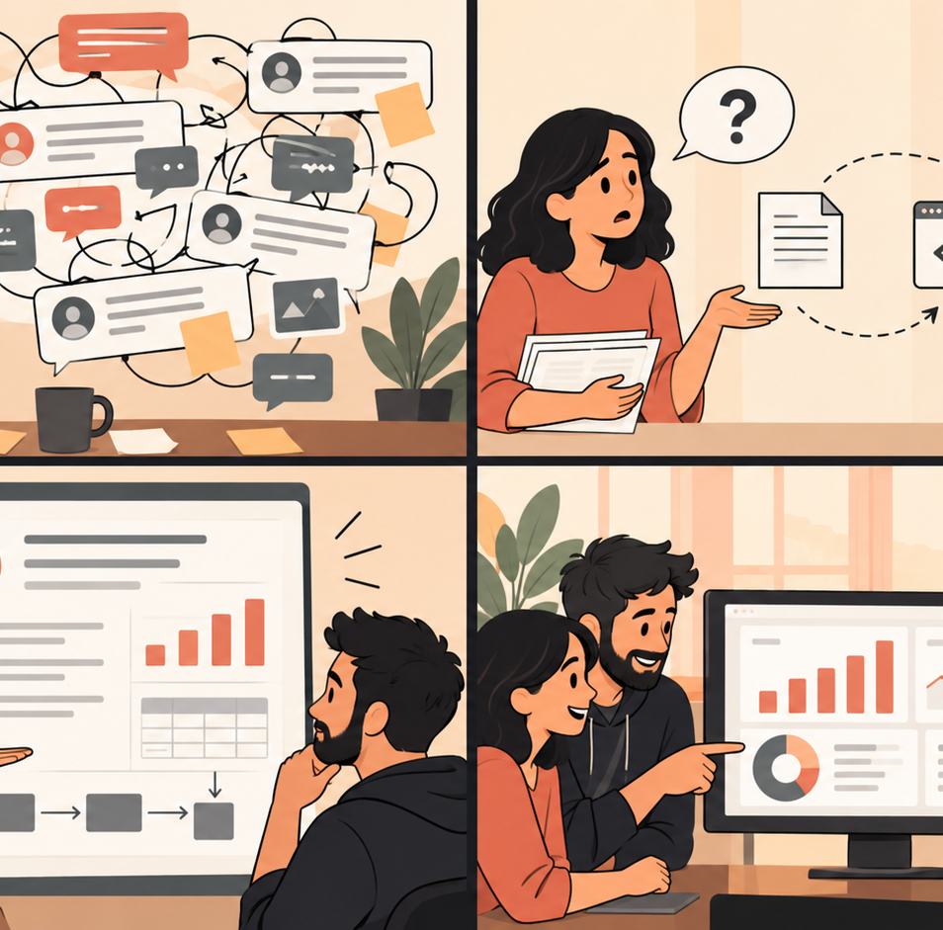
Common failures
Most failures are workflow failures, not model mysteries
✓
Beautiful but wrong
✓
No data contract
✓
Hidden assumptions
✓
Public-share leakage
✓
Unreviewed Skill code
✓
Cache misses from changing context
Fix with: acceptance tests, targeted revisions, source notes and sharing review.
GenAI Basics · Module 09
20
Notes:
Module 09 slide 20. Use the instructor script for full narration. Keep the frame practical: artifact, tests, governance.

Slide 21
Key takeaways
What should stick after the laptop closes
Workbench
Claude is more than chat; choose the surface deliberately.
Artifact
Specify the work product and test it.
API
Your application owns state and side effects.
Skills
Reusable capability needs ownership and review.
Governance
Sharing, files and tools are product decisions.
GenAI Basics · Module 09
21
Notes:
Module 09 slide 21. Use the instructor script for full narration. Keep the frame practical: artifact, tests, governance.

Slide 22
Q&A
Next: Open Models — local inference, LM Studio and hosted GPU workflows
GenAI Basics · Module 09
22
Notes:
Module 09 slide 22. Use the instructor script for full narration. Keep the frame practical: artifact, tests, governance.

